Slide 1
CELLULAR NETWORK ANALYSIS WITH MACHINE LEARNING
Project by:
Kenneth Nyangweso
Graduate Engineer | Data Scientist

Slide 2
CONTENTS
Business Understanding
Data Understanding
Data Analysis
Modeling
Evaluation
Conclusion
Recommendation

Slide 3
Business understanding
In the telecommunications industry, maintaining high-quality cellular network performance is critical for customer satisfaction, retention, and operational efficiency. This project uses a real-world dataset containing geolocated signal measurements and network performance metrics to analyze and model key indicators of network health. By combining regression and classification approaches, the aim is to evaluate and predict network performance and classify zones based on service quality.

Slide 4
WHY NOW?
In the telecommunications industry, maintaining high-quality cellular network performance is critical for customer satisfaction, retention, and operational efficiency. This project uses a real-world dataset containing geolocated signal measurements and network performance metrics to analyze and model key indicators of network health.

Slide 5
OBJECTIVES
Predict continuous performance metrics i.e signal strength (Dbm) and data throughput (mbps)
Predict the network type (e.g., 3G, 4G, 5G) based on observed signal and performance data.
Compare the reliability of different signal measurement tools (BB60C, srsRAN, BladeRFxA9).

Slide 6
METRICS OF SUCCESS
Task | Metrics
Regression | R-Squared, MSE, MAE RMSE
Network Type Classification | Accuracy, F1-Score
Feature Importance | Feature Importance Graph

Slide 7
DATA UNDERSTANDING
The dataset contains signal quality measurements from various geographic locations and cellular network types. The goal is to assess and model the quality of service across different network types and environments.

Slide 8
EXPLORATORY DATA ANALYSIS
Uni-variate Analysis
Bi-variate Analysis
Multi-variate Analysis

Slide 9
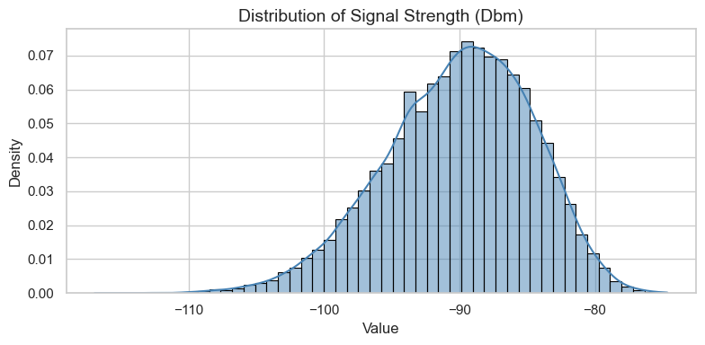
UNI-VARIATE analysis
The distribution is approximately normal, centered around -90 dBm, which represents typical signal strengths within the dataset.

Slide 10
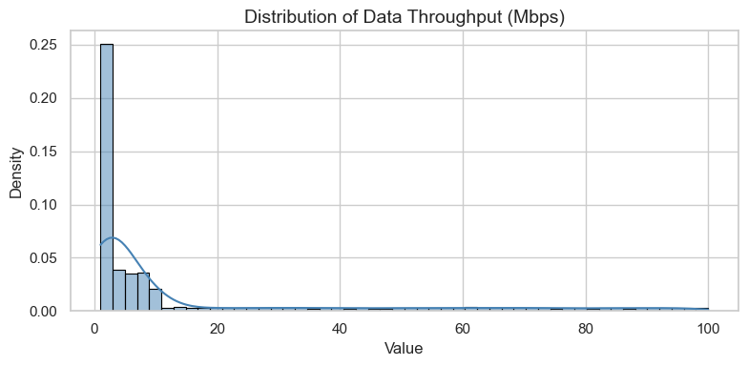
THROUGHPUT DISTRIBUTION.
This feature is highly skewed towards lower values, indicating that most measurements show lower data speeds, with fewer instances of high throughput.

Slide 11
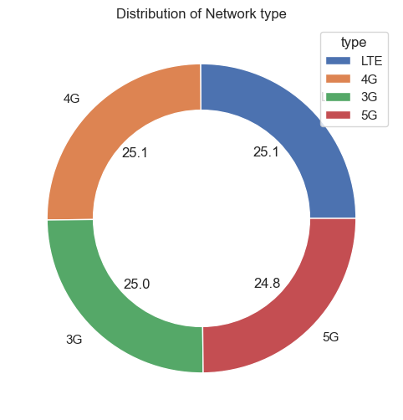
Network type distribution
Each category accounts for approximately 25% of the total, suggesting a nearly uniform distribution among these network types.

Slide 12
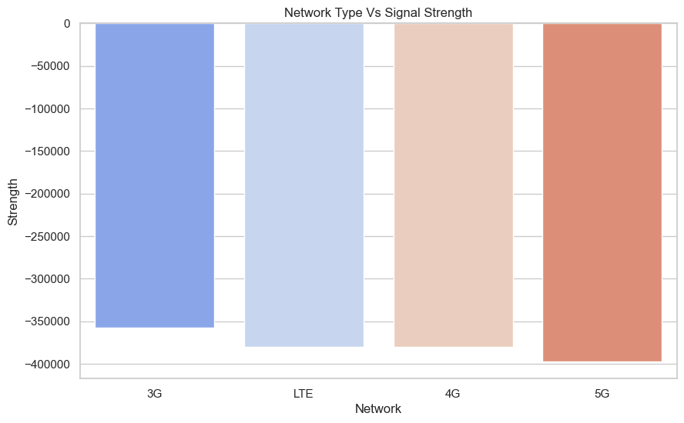
BI-VARIATE ANALYSIS
It appears that 3G has the least negative (strongest) signal strength among the observed network types.
LTE and 4G have very similar signal strengths, which are slightly weaker (more negative) than 3G.
5G has the most negative (weakest) signal strength among the categories.

Slide 13
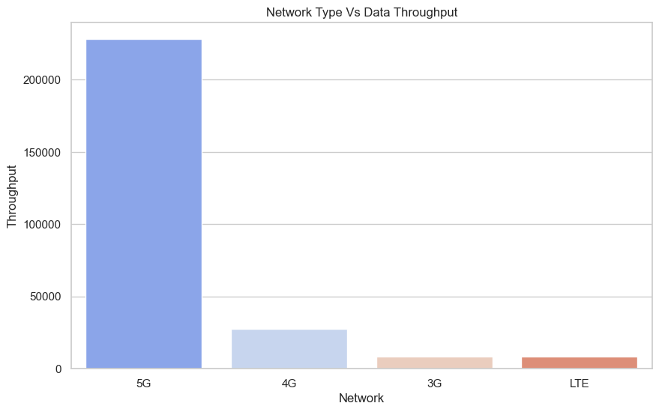
NETWORK TYPE VS THROUGHPUT
5G demonstrates vastly superior Data Throughput compared to all other network types. It is an order of magnitude higher than 4G, and significantly higher than 3G and LTE.
There's a clear descending trend in Data Throughput from 5G to 4G, then to 3G, and finally to LTE.

Slide 14
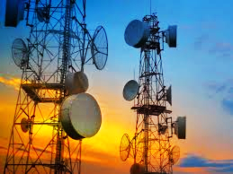
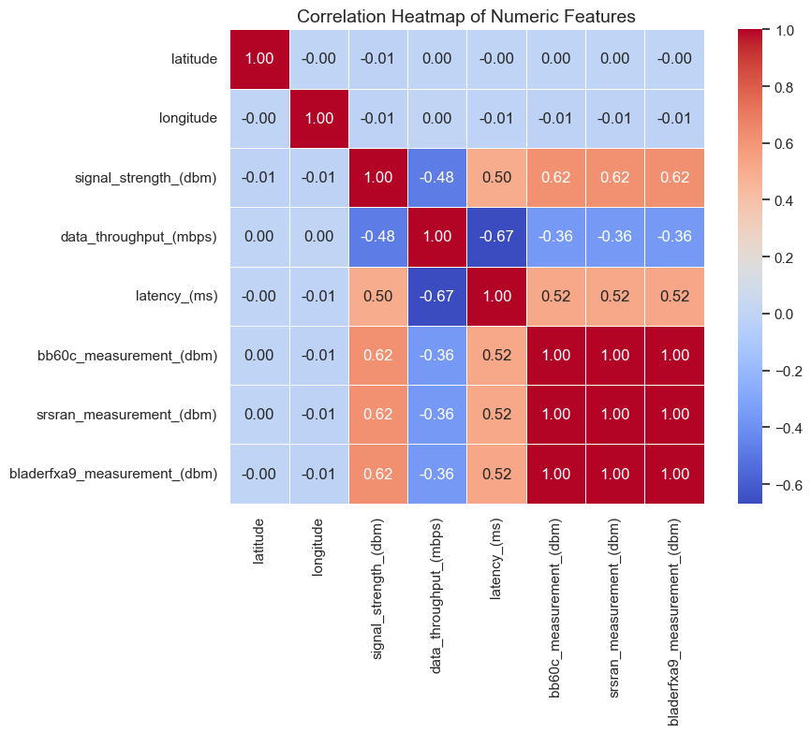
MULTI-VARIATE ANALYSIS
Signal Strength vs. Latency: There is a strong positive correlation of 0.50 between signal strength_(Dbm) and latency_(ms).
Signal Strength vs. Data Throughput: There is a strong negative correlation of -0.48 between signal strength_(Dbm) and data throughput_(mbps). This is also counter-intuitive: it suggests that as signal strength increases, data throughput decreases.
Throughput vs. Latency: There is a strong negative correlation of -0.67 between data throughput_(mbps) and latency_(ms). This is an expected and logical correlation: as data throughput increases, latency decreases.

Slide 15
MODELING
REGRESSION: Linear Regression, Random Forest Regressor, XGBoost Regressor
CLASSIFICATION: Random Forest Classifier

Slide 16
EVALUATION
METRIC | RANDOM FOREST REGRESSOR | XGBOOST REGRESSOR | BEST PERFORMANCE
R-Squared | 89.4% | 89.3% | Random Forest
MAE | 1.18% | 1.21% | XGBoost
RMSE | 1.73% | 1.74% | XGBoost
METRIC | ACCURACY | F1-SCORE
RANDOM FOREST CLASSIFIER | 100% | 100%

Slide 17
CONCLUSION
Nearly equal distribution across LTE, 4G, 3G, and 5G networks (~25% each).
Strongest Signal in 3G, Weakest in 5G
Superior Throughput in 5G
XGBoost for Signal Strength Prediction
Exceptional Throughput Prediction Performance
Perfect Classification with Random Forest

Slide 18
RECOMMENDATIONS
Invest in denser 5G infrastructure (e.g., small cells) to address weaker signal strength issues and ensure coverage parity with 3G and LTE.
Given their strong signal characteristics, 3G and LTE networks can continue serving areas where 5G infrastructure is sparse or signal penetration is critical.
Due to its high accuracy and generalizability, XGBoost should be integrated into real-time systems for signal strength and throughput forecasting.
Continue tracking temporal patterns in signal and throughput to anticipate demand and preemptively manage resources.

Slide 19
THANK YOU
Kenneth Nyangweso
https://github.com/kennethnyangweso/Cellular-Network-Analysis-with-Machine-Learning
www.linkedin.com/in/kenneth-nyangweso-4b429b242

